Slide 1
Webstore Design
-Personal Project Announcement-
Day : June 13th Thu
Name : Jung In Yeon

Slide 2
Index
Web programming language
Main page
Register page
Login page
Logout page
Product page
Cart page
Admin page

Slide 3
1. Web programming language
HTML
CSS
JS
PHP
JSP
ASP
NET

Slide 4
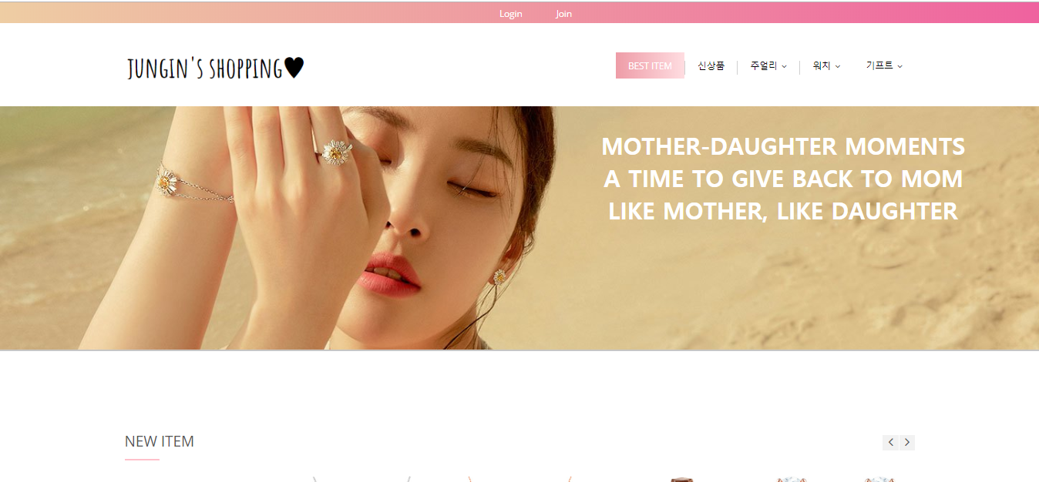
1. Main page

Slide 5
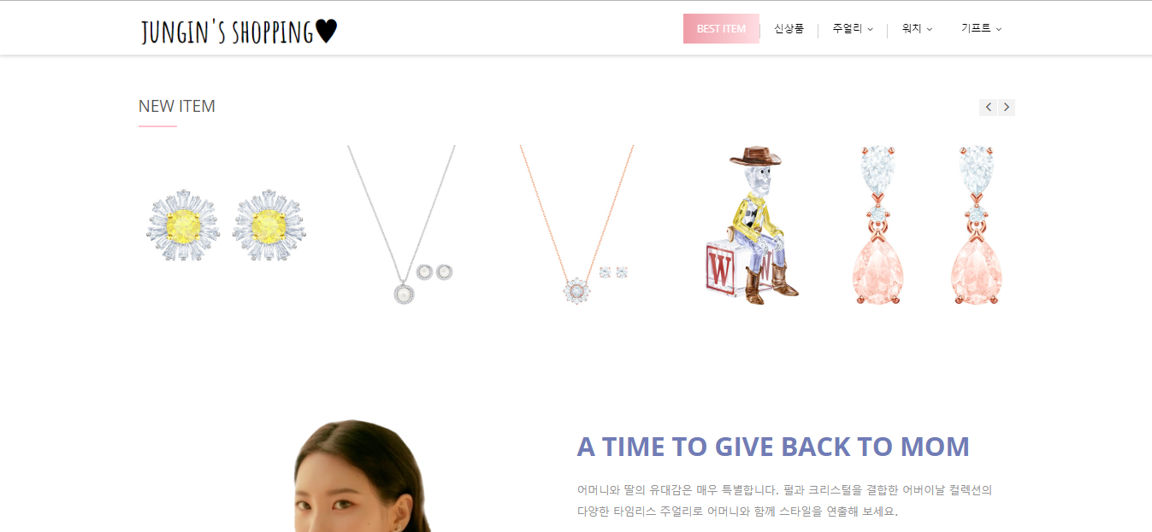
1. Main page

Slide 6
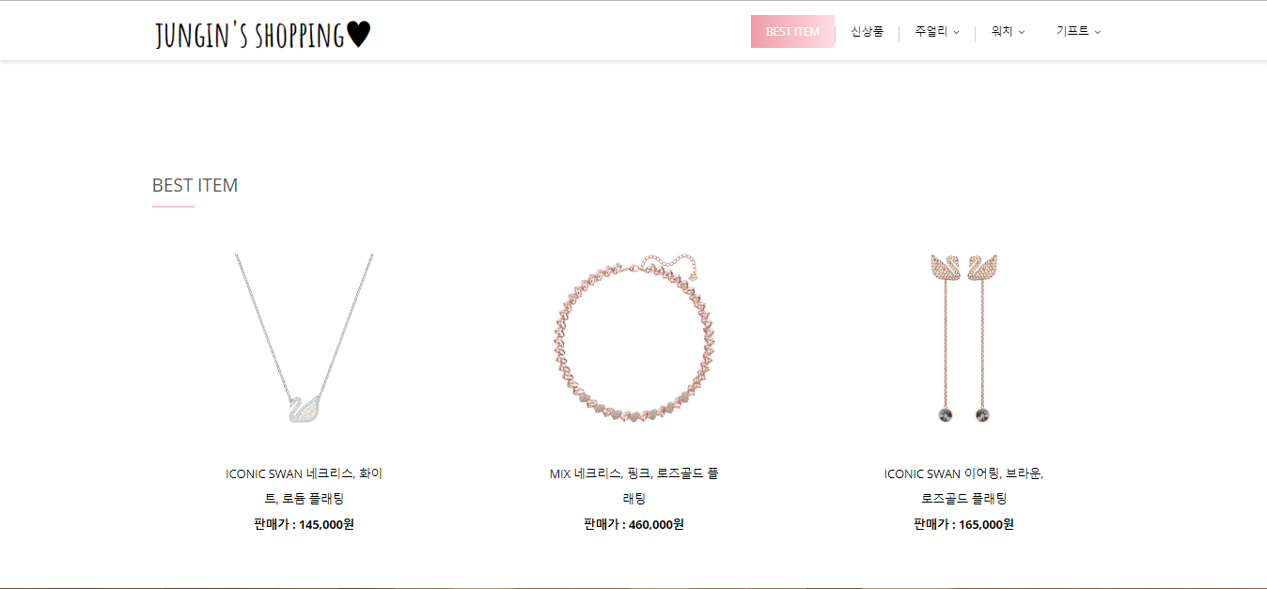
1. Main page

Slide 7
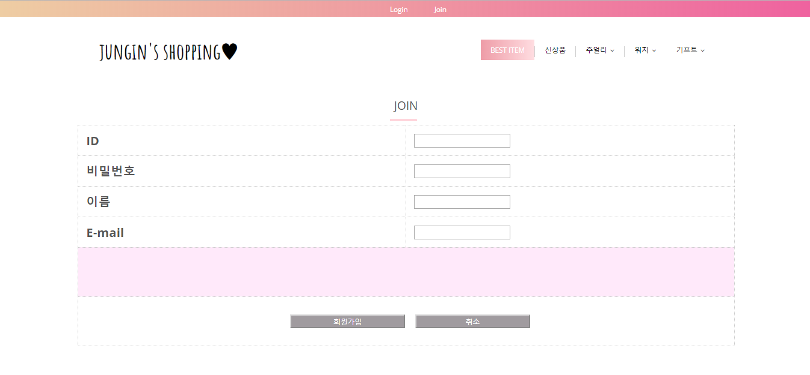
2. Register page

Slide 8
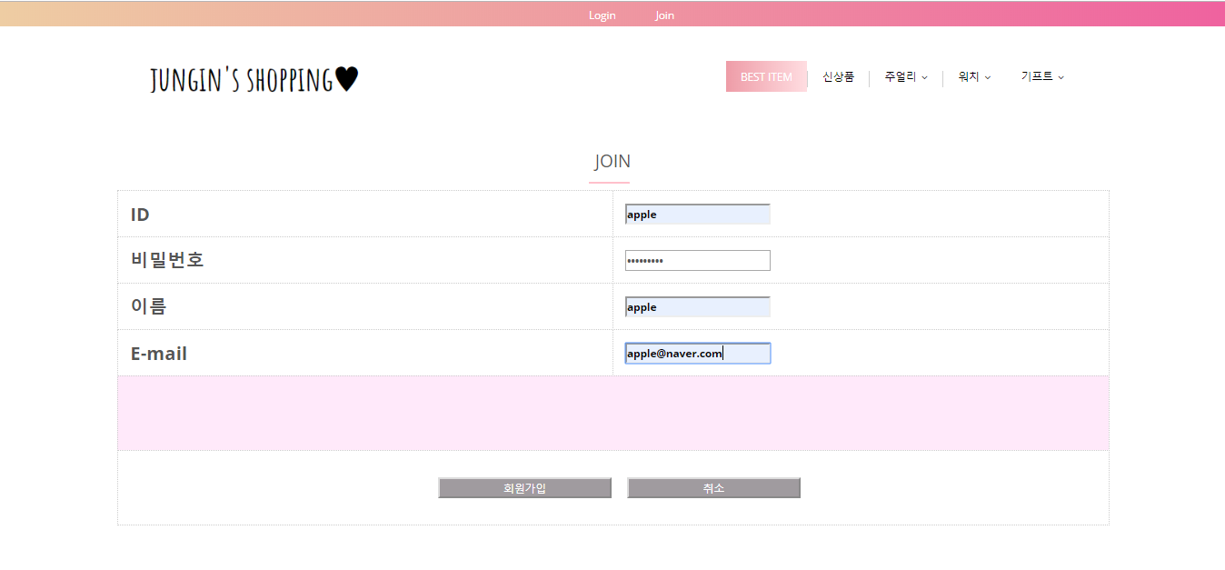
2. Register page

Slide 9
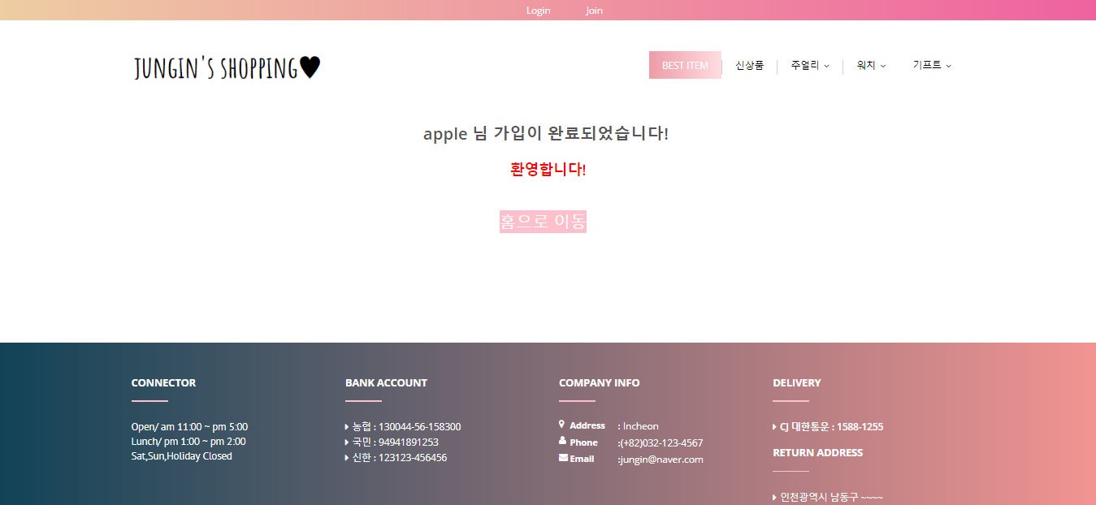
2. Register page

Slide 10
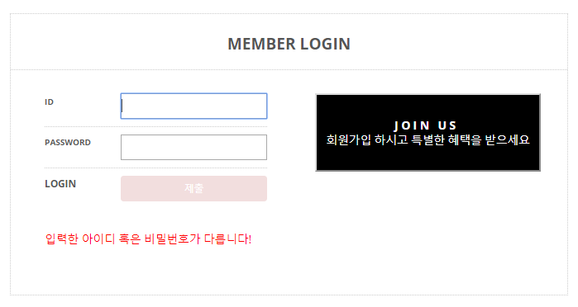
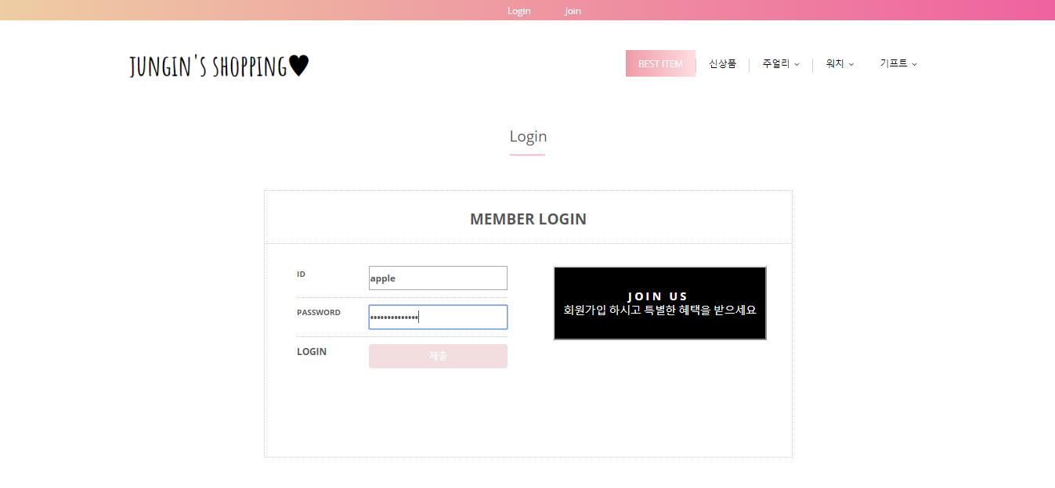
3. Login page

Slide 11
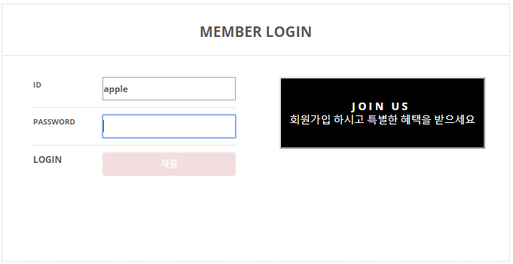
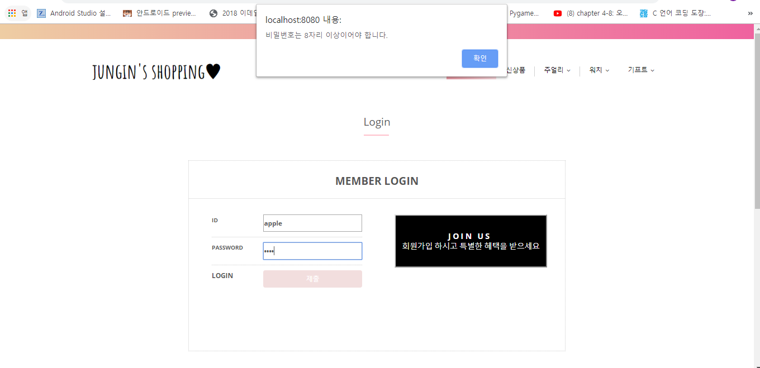
3. Login page

Slide 12
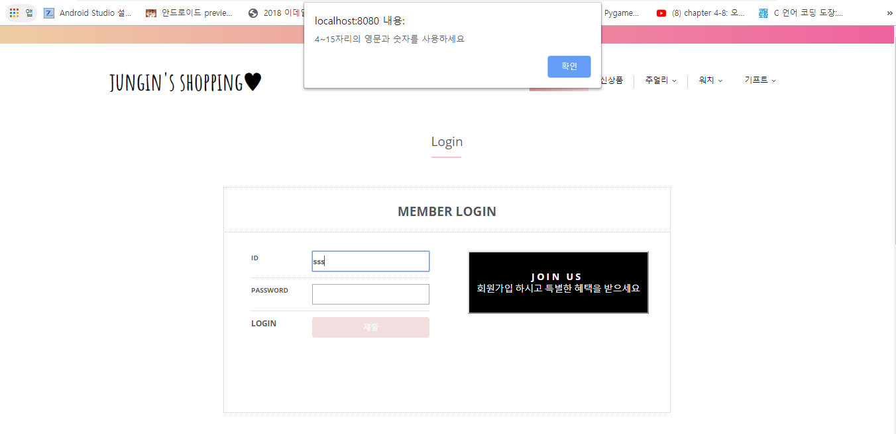
3. Login page

Slide 13
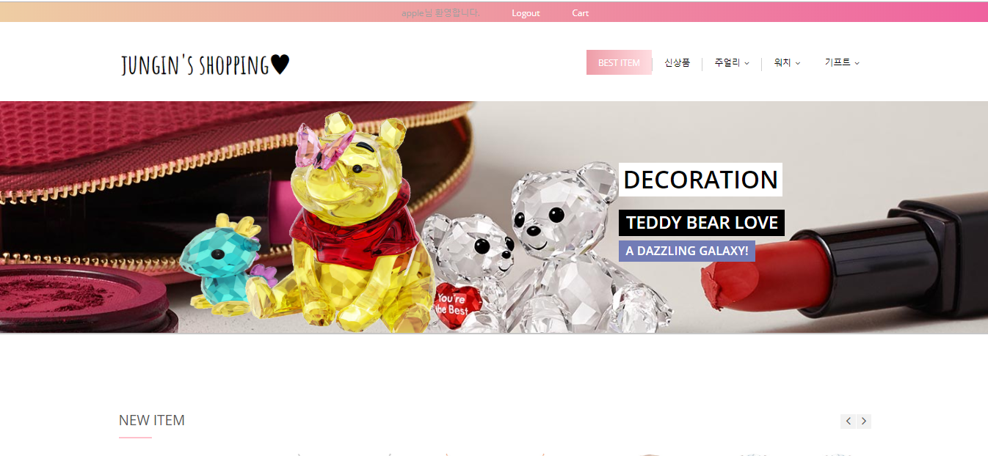
3. Login page

Slide 14
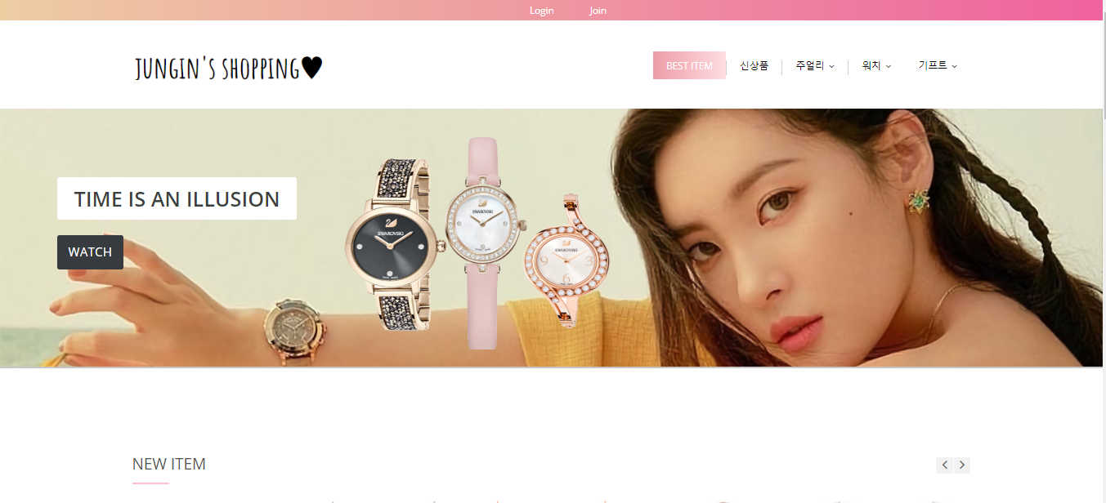
4. Logout page

Slide 15

5. Product page

Slide 16
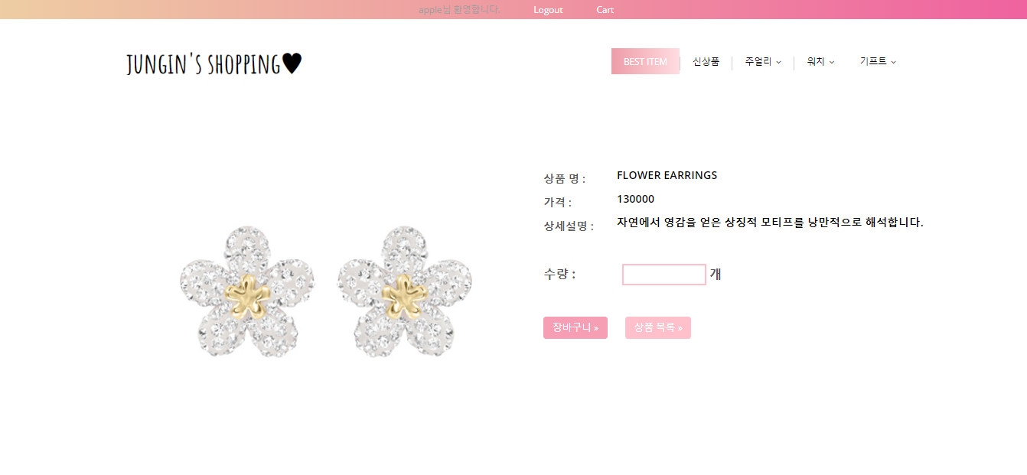
5. Product page

Slide 17
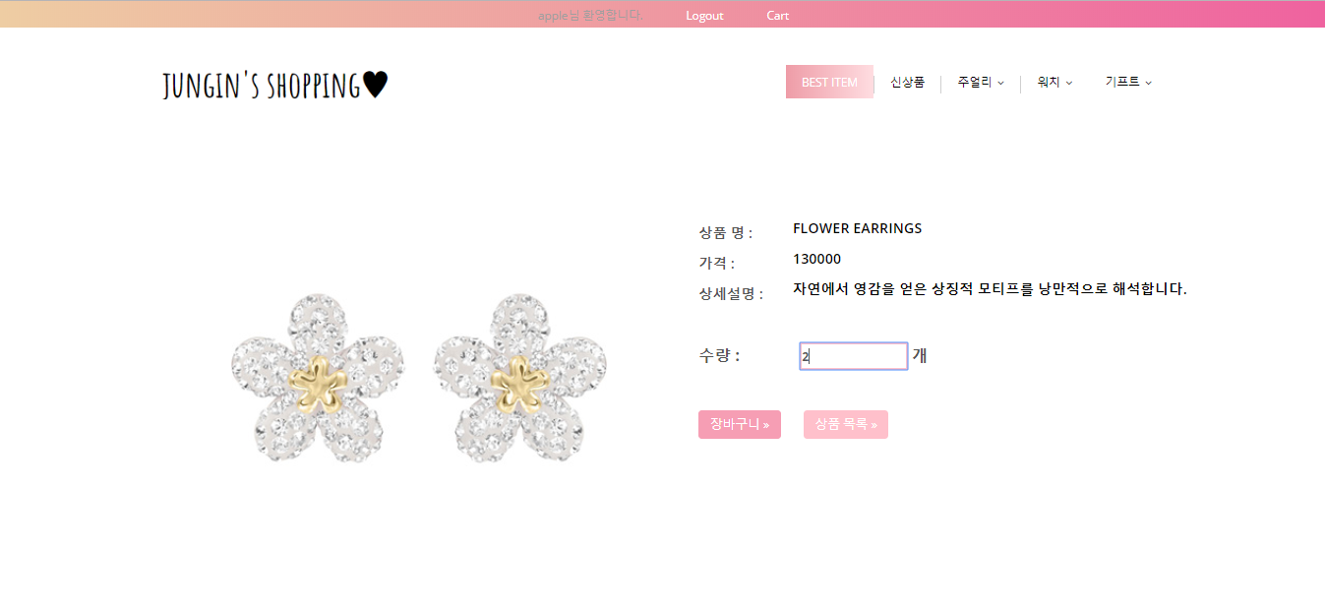
5. Product page

Slide 18

5. Product page

Slide 19
5. Product page

Slide 20
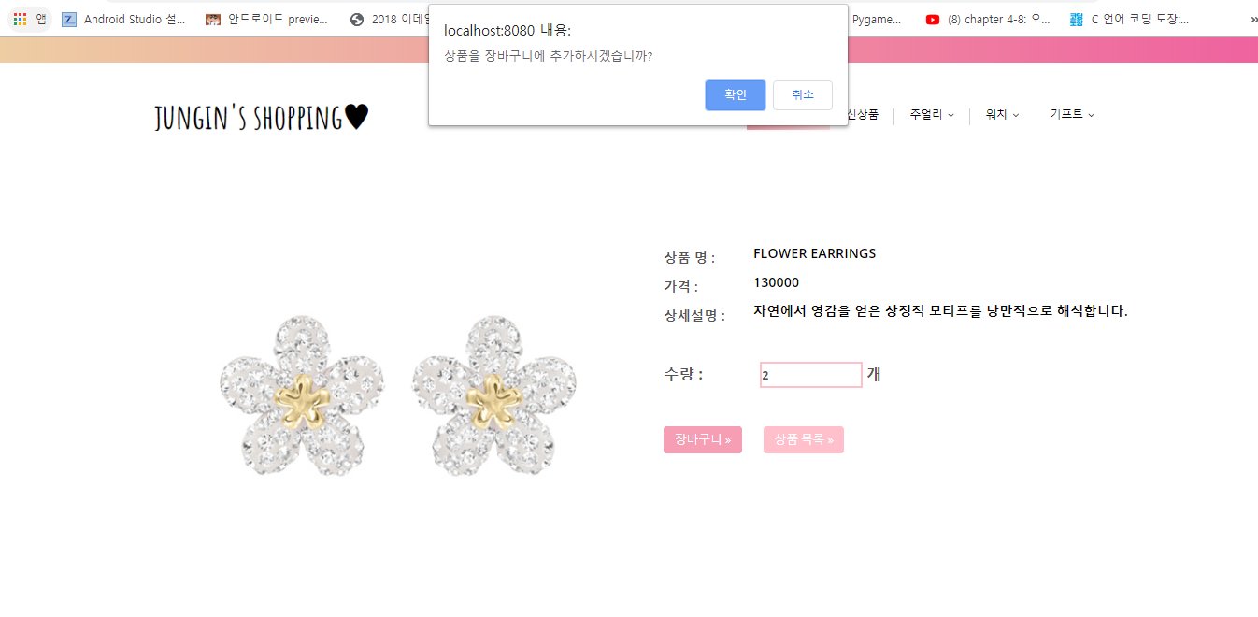
5. Product page

Slide 21
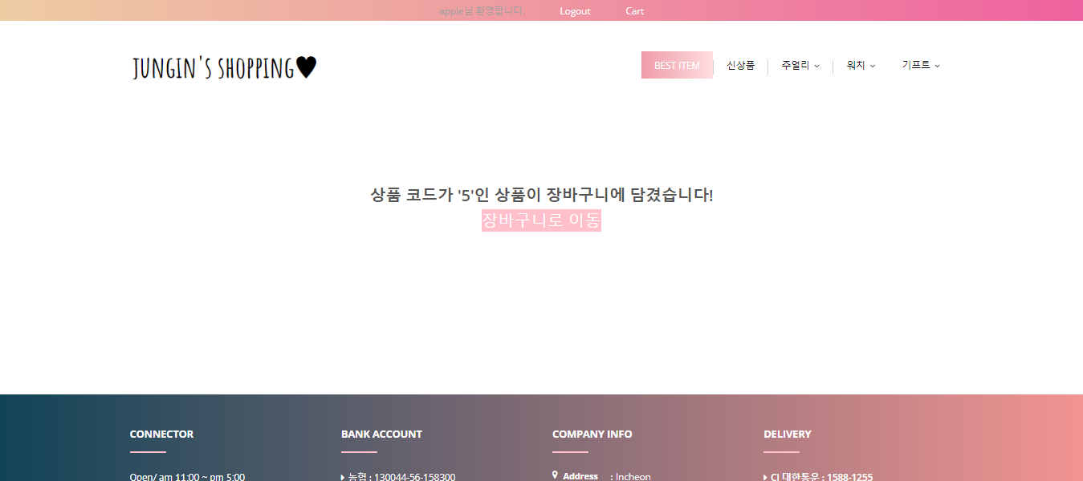
6. Cart page

Slide 22
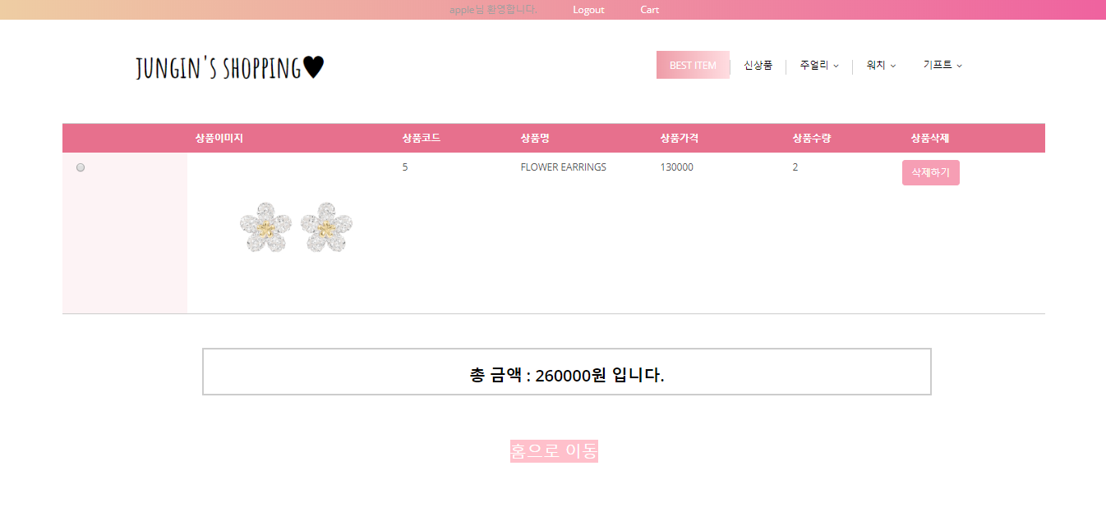
6. Cart page

Slide 23
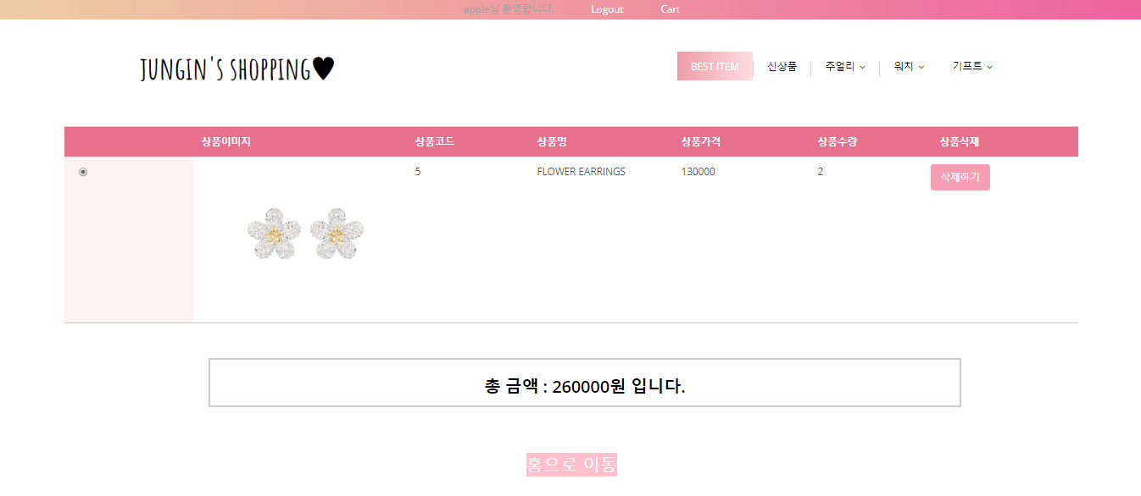
6. Cart page

Slide 24
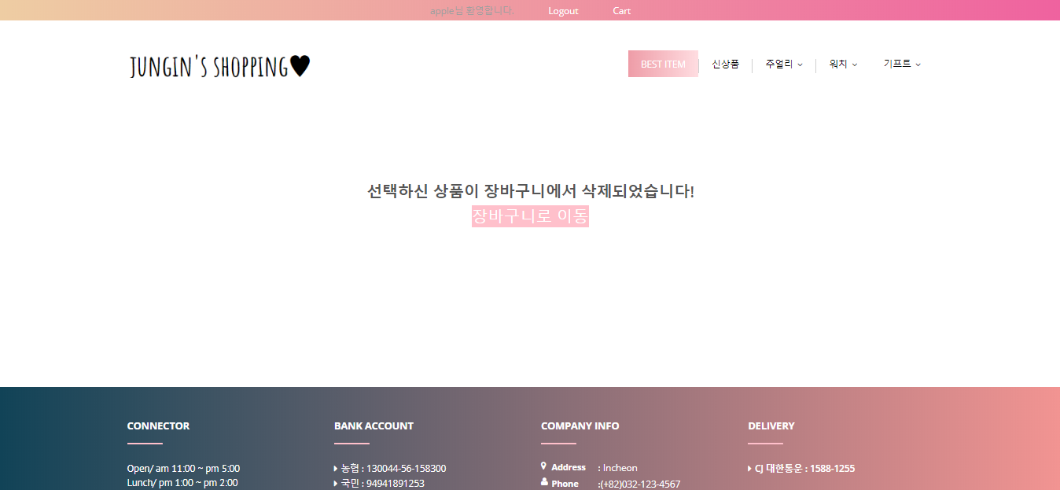
6. Cart page

Slide 25
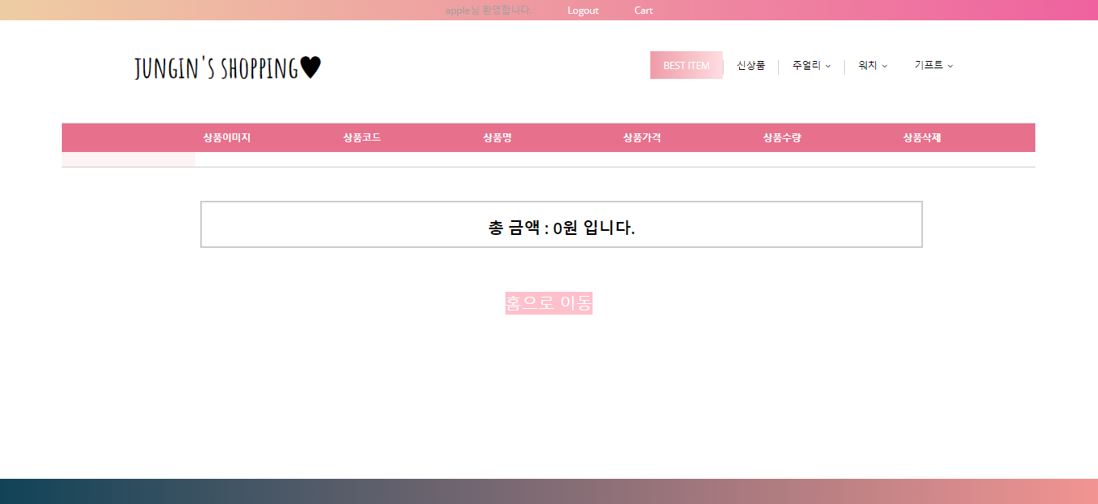
6. Cart page

Slide 26
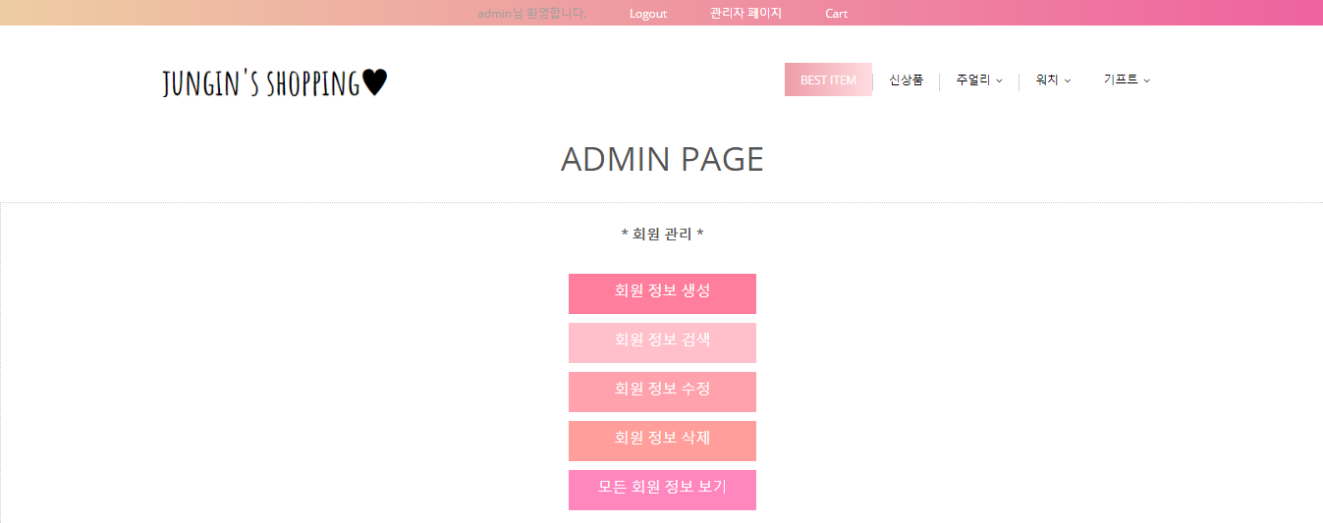
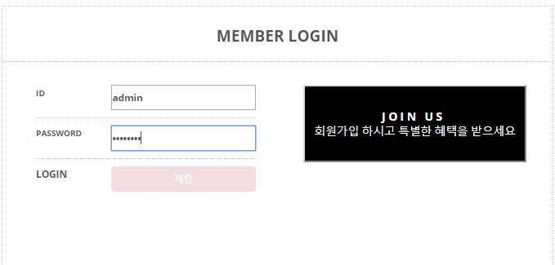
7. Admin page

Slide 27
7. Admin page

Slide 28
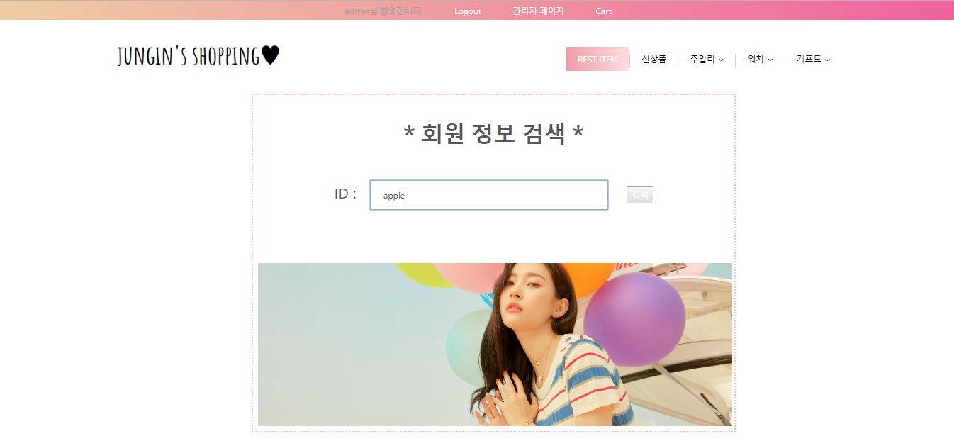
7. Admin page

Slide 29
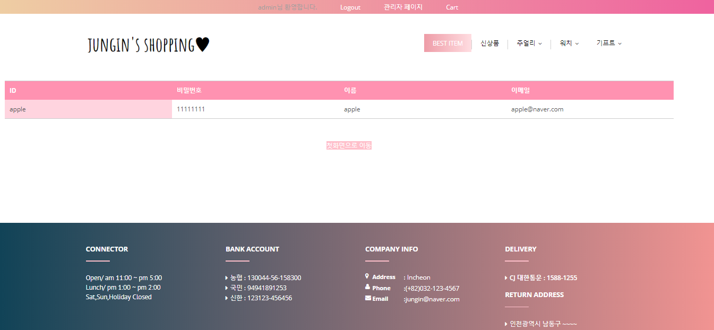
7. Admin page

Slide 30
7. Admin page

Slide 31
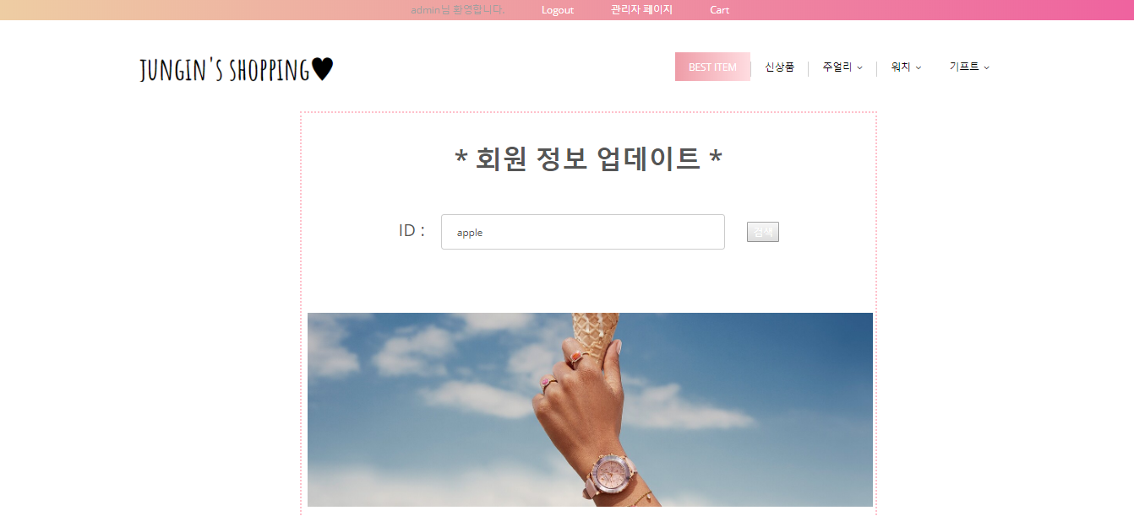
7. Admin page

Slide 32
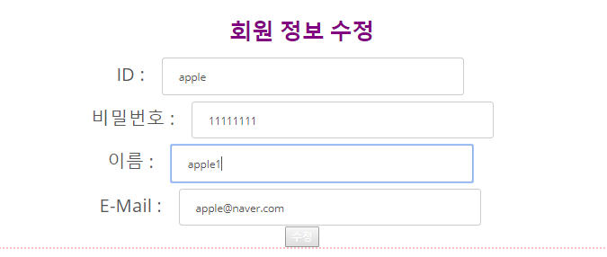
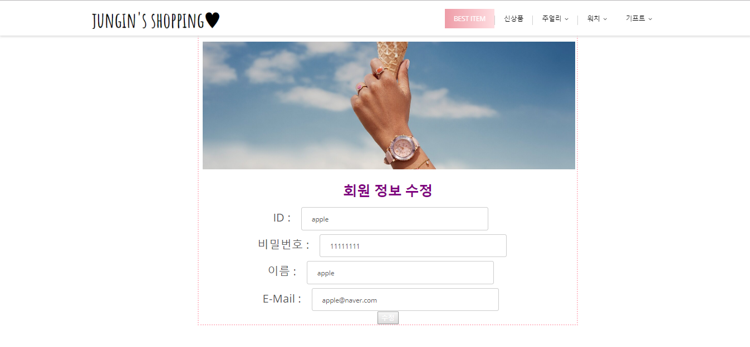
7. Admin page

Slide 33
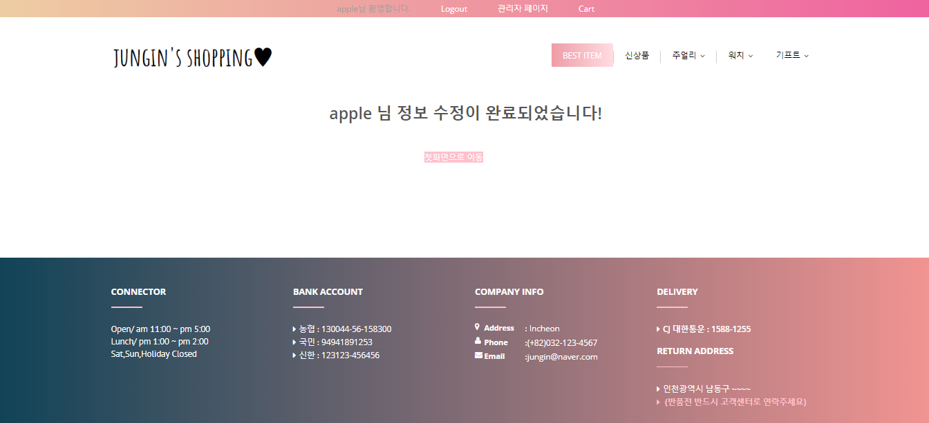
7. Admin page

Slide 34
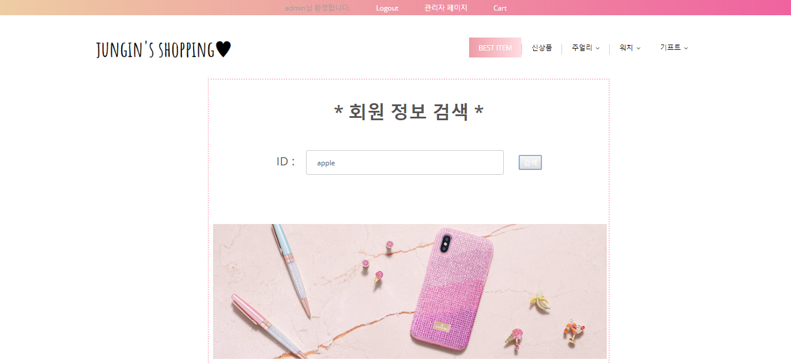
7. Admin page

Slide 35
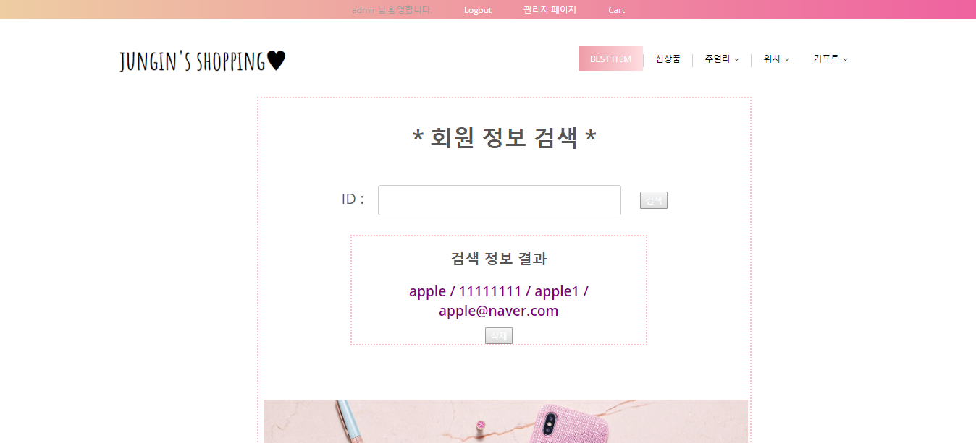
7. Admin page

Slide 36
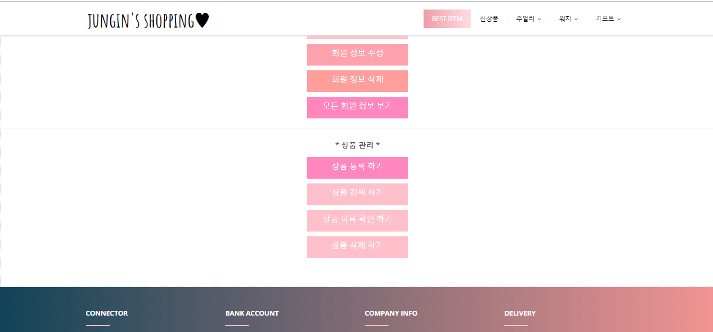
7. Admin page

Slide 37
7. Admin page

Slide 38
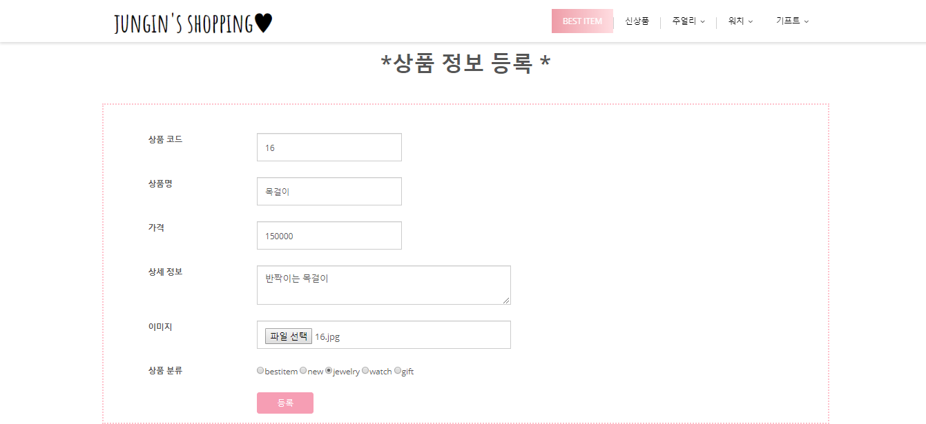
7. Admin page

Slide 39
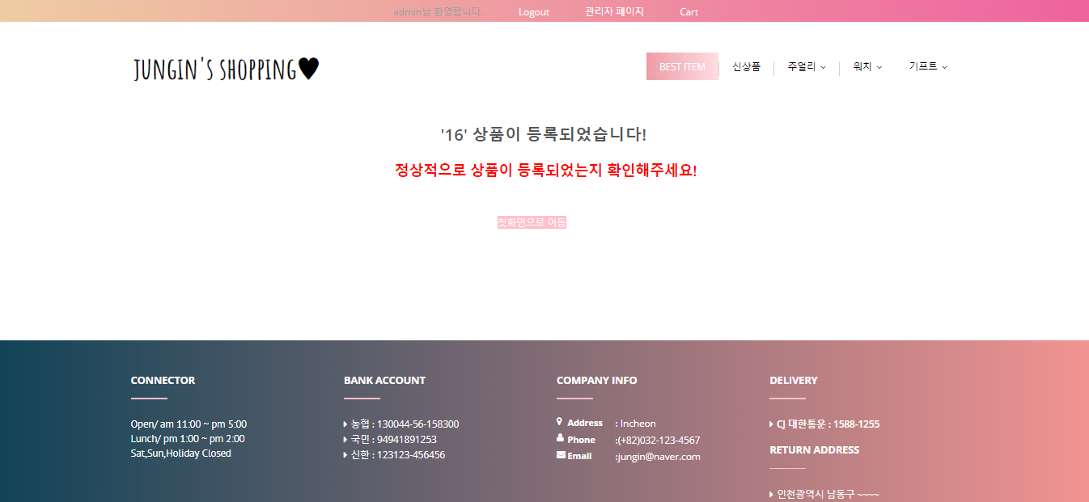
7. Admin page

Slide 40
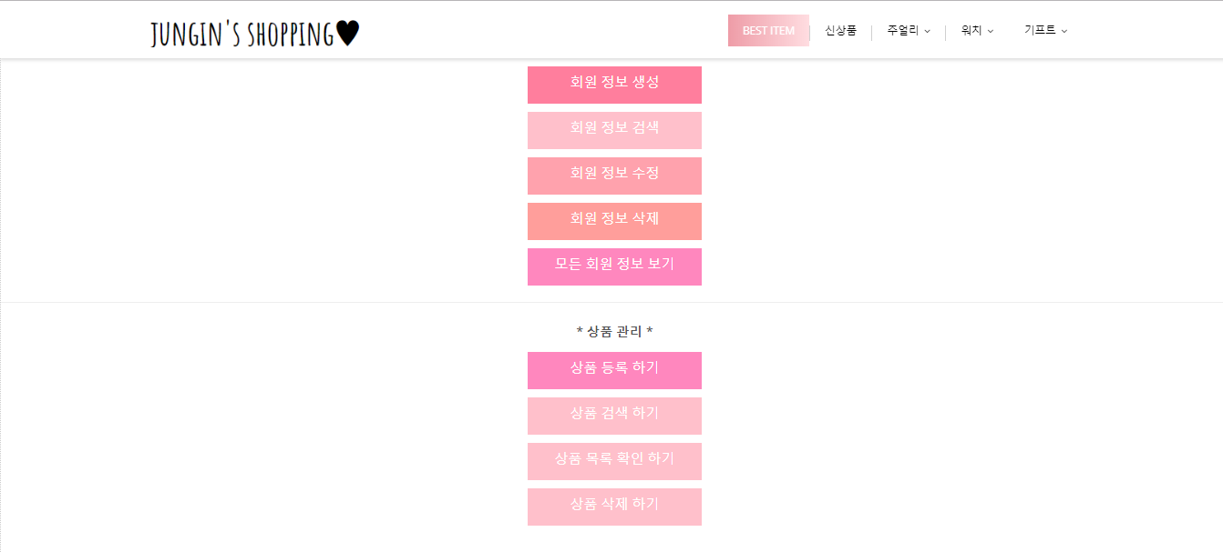
7. Admin page

Slide 41
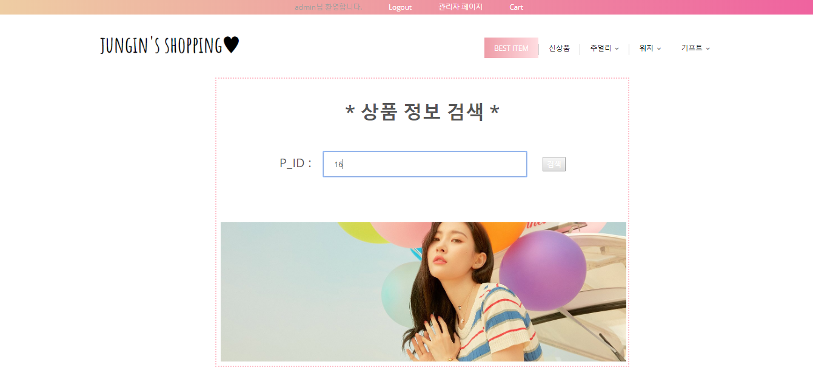
7. Admin page

Slide 42
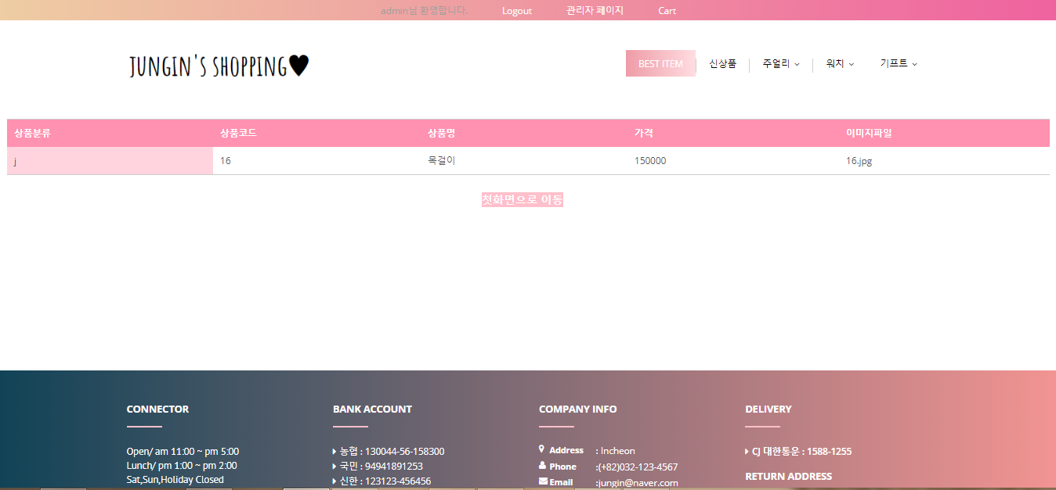
7. Admin page

Slide 43
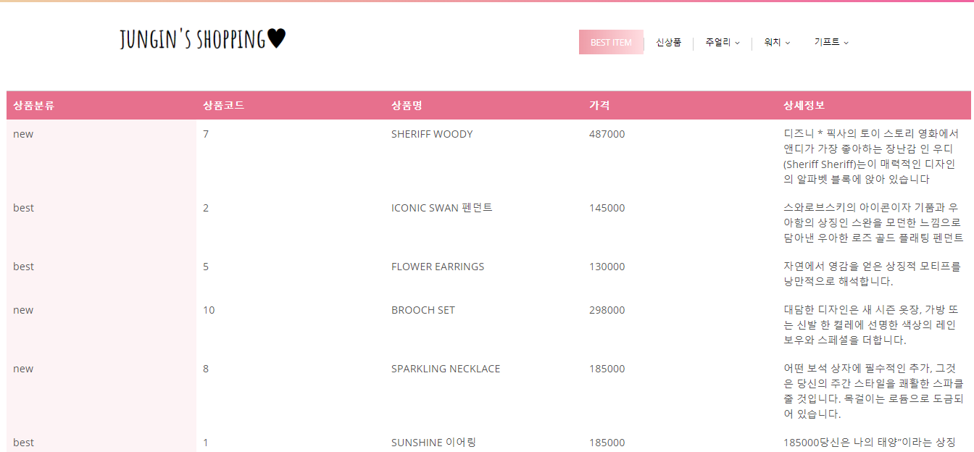
7. Admin page

Slide 44
7. Admin page

Slide 45
7. Admin page

Slide 46
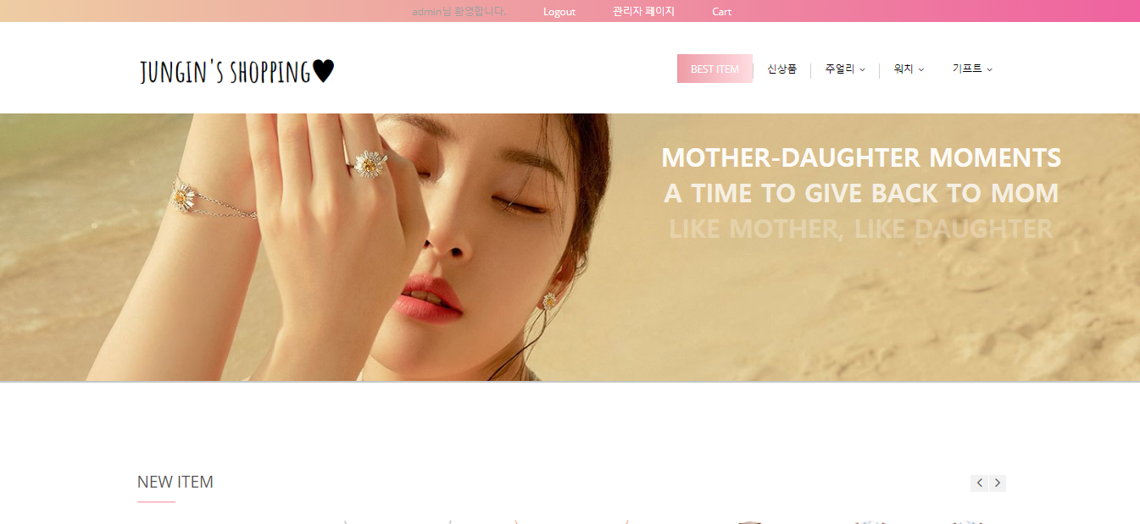
7. Admin page

Slide 47
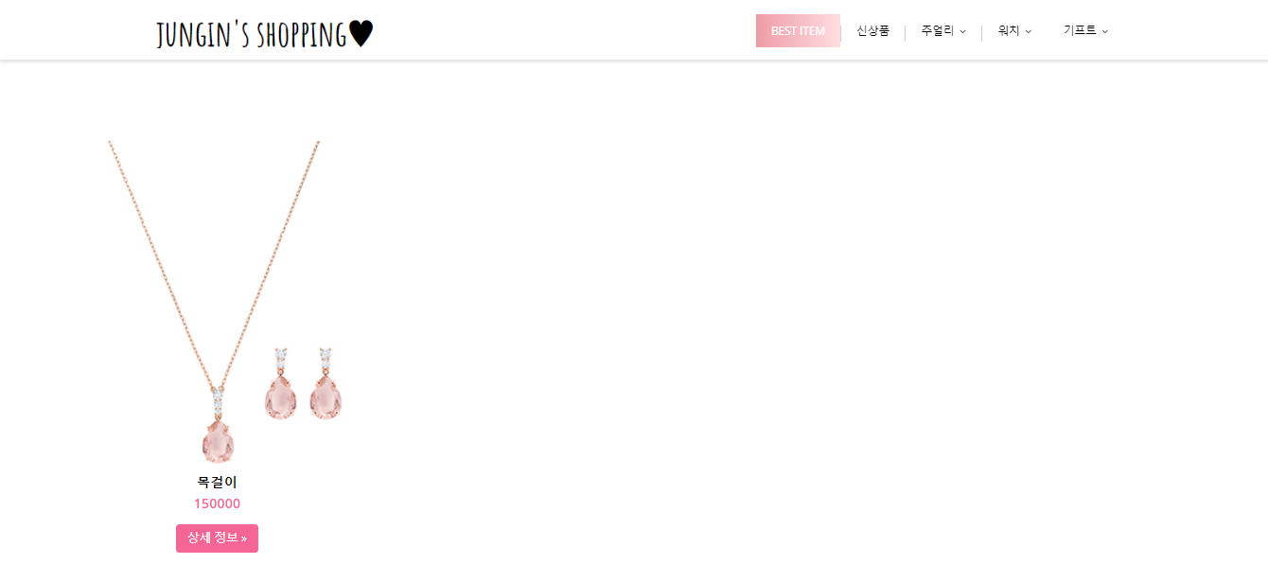
7. Admin page

Slide 48
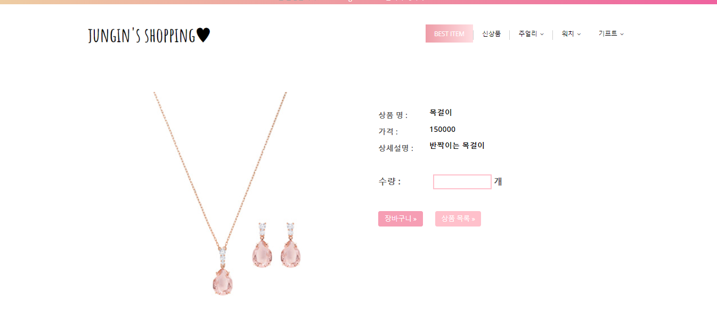
7. Admin page

